Slide 1
Conociendo TypeScript
Mariano Sánchez – Software Architect
sanchezmariano@outlook.com @marianosz
http://weblogs.asp.net/marianos

Slide 2
Why TypeScript?
Notes:
Javascript is popular Large applications on Javascript is hard
Only cross plataform language in town
Never concieved to large application development (100 or 1000 lines) now write (10000 of lines)
Very hard in a language that lacks of structures like classes, modules, types, in particullar dont have a static type system => good tooling

Slide 3
Script# → C# to Javascript
☹
Notes:
Cross compile from other languajes
JAVA: http://www.gwtproject.org/overview.html
C# https://github.com/nikhilk/scriptsharp

Slide 4
GWT → Java to Javascript
☹ ☹
Notes:
Cross compile from other languajes
JAVA: http://www.gwtproject.org/overview.html
C# https://github.com/nikhilk/scriptsharp

Slide 5
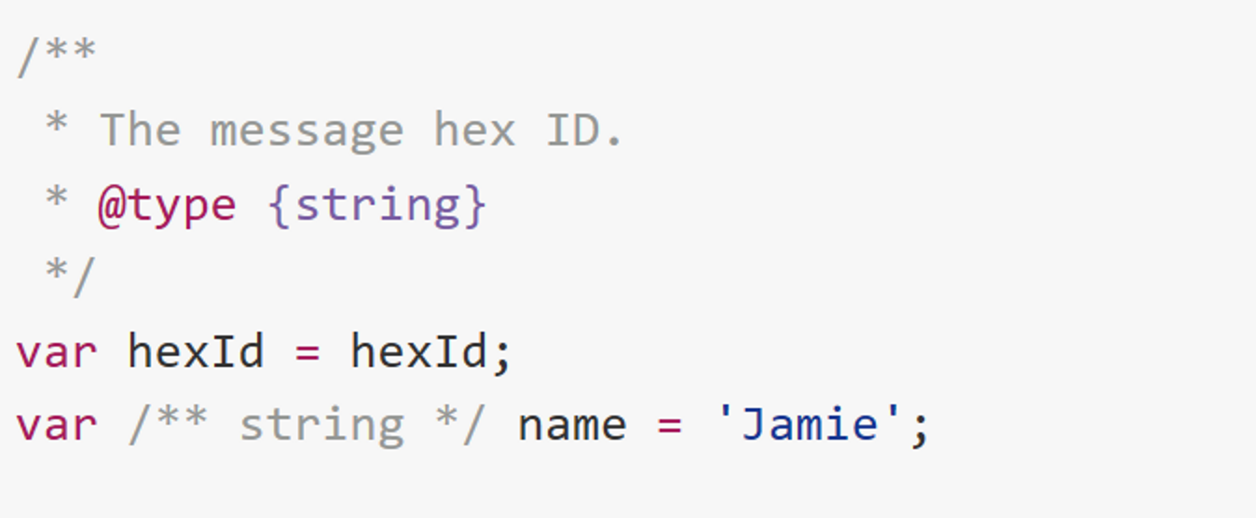
Javascript → Google Closures
☹ ☹ ☹
Notes:
Cross compile from other languajes
JAVA: http://www.gwtproject.org/overview.html
C# https://github.com/nikhilk/scriptsharp

Slide 6


Lead architect of C# and core developer on TypeScript.
Anders Hejlsberg
Notes:
Cross compile from other languajes
JAVA: http://www.gwtproject.org/overview.html
C# https://github.com/nikhilk/scriptsharp

Slide 7
TypeScript: JavaScript that scales.
Notes:
TypeScript is a free and open source programming language developed and maintained by Microsoft.
It is a strict superset of JavaScript, and adds optional static typing and class-based object-oriented programming to the language.
TypeScript may be used to develop JavaScript applications for client-side or server-side (Node.js) execution.
TypeScript is designed for development of large applications and transcompiles to JavaScript.^{[6]} As TypeScript is a superset of JavaScript, any existing JavaScript programs are also valid TypeScript programs.

Slide 8
A statically typed superset of JavaScript that compiles to plain JavaScript.
Notes:
"Adding those thing that are mising to js (superset)"
Two major things:
The main one is static type
Powers the great tooling of C# or Java (
IDE knows whats going on
* Statement Completion (intellisense)
* Refactiring
* Find all references)
Remove it => Guess Work
Ex refactoring (Property call "Text") = MESS
Large JS code bases => Read Only (nobady touch it)
Types are optional => As much you type the more IDE can help you
- USe features froim the future, today
Features of ECMA 6 (Spec done)
Classes
Modules
Error Functions
You can use it form the following 3 years (Older Browser Issue)
Downlevel compile ECMA 6 features to EMCA 5 sintax

Slide 9
Any Library. Any browser. Any host. Any OS.
Notes:
TypeScript supports definition files that can contain type information of existing JavaScript libraries, much like C/C++ header files can describe the structure of existing object files. This enables other programs to use the values defined in the files as if they were statically typed TypeScript entities. There are third-party header files for popular libraries like jQuery, MongoDB, and D3.js.
The TypeScript compiler is itself written in TypeScript, transcompiled to JavaScript
- Cross platform
Typescript compiler wrote in Typescript

Slide 10
Open Source.
Notes:
-Open Source
Github

Slide 11


Great tools enabled by static types
Features from the future, today!
Notes:
Typescript = JS + Types + Tooling => compiles to JS that runs everywhere
We can use all the existen frameworks that exists today
- USe features froim the future, today
Features of ECMA 6 (Spec done)
Classes
Modules
Error Functions
You can use it form the following 3 years (Older Browser Issue)
Downlevel compile ECMA 6 features to EMCA 5 sintax

Slide 12
The feature gap
ES2015
ES2016
ES2017
ES2018
ES3
ES5
JavaScript Evolution
State of web JS
State of server JS
State of the art JS
Target
Productivity
JavaScript feature gap
March 2015
March 2016

Slide 13
Demo

Slide 14
Nullable types
string
number
boolean
'a'
''
0
1
'b'
'hello'
'42'
true
false
42
…
2
0.25
…
undefined
null
undefined
undefined
null
null

Slide 15
Nullable types
string
number
boolean
'a'
''
0
1
'b'
'hello'
'42'
true
false
42
…
2
0.25
…
undefined
null
undefined
undefined
null
null
number | string

Slide 16
Nullable types
string
number
boolean
'a'
''
0
1
'b'
'hello'
'42'
true
false
42
…
2
0.25
…
undefined
null
undefined
undefined
null
null

Slide 17
Non-nullable types
string
number
boolean
'a'
''
0
1
'b'
'hello'
'42'
true
false
42
…
2
0.25
…
undefined
null
undefined
undefined
null
null

Slide 18
Non-nullable types
string
number
boolean
'a'
''
0
1
'b'
'hello'
'42'
true
false
42
…
2
0.25
…
undefined
null
undefined
null

Slide 19
Non-nullable types
number
number | undefined
0
1
2
42
0.25
…
undefined
undefined

Slide 20
Non-nullable types
string | null | undefined
string
'a'
''
'b'
'hello'
'42'
…
undefined
null
undefined
null

Slide 21
Demo

Slide 22








TypeScript tools
Visual Studio
Sublime Text
Atom
WebStorm
Visual Studio Code
Eclipse
Emacs
Vim

Slide 23
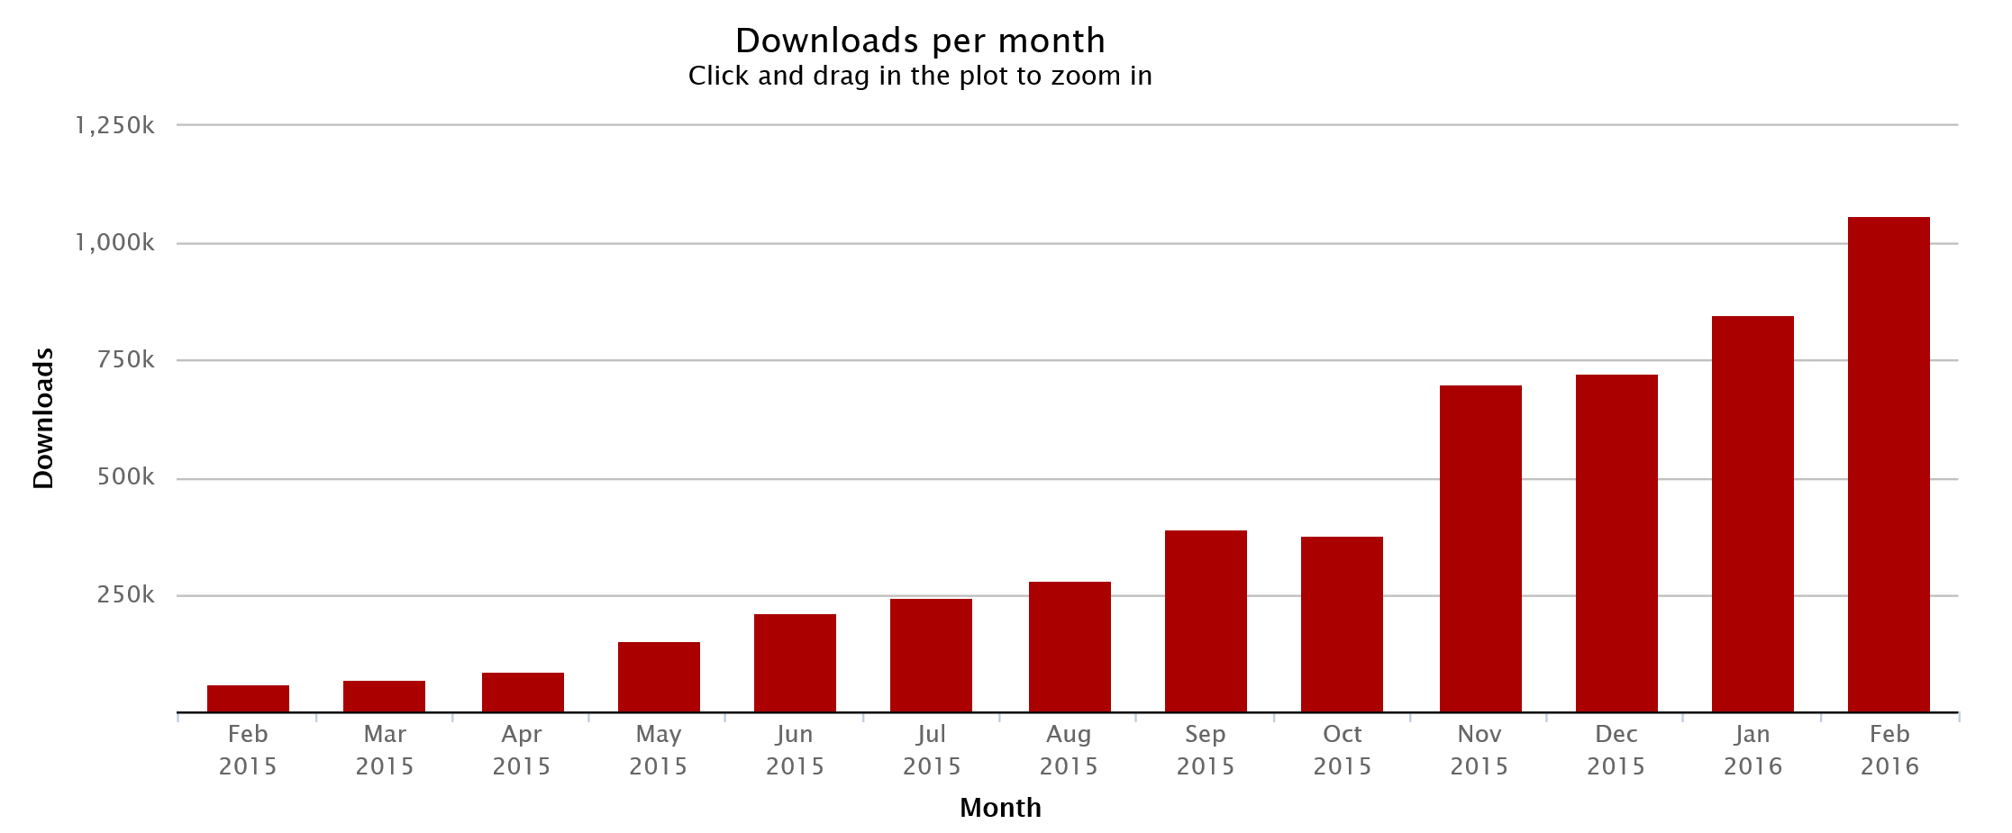
TypeScript adoption

Slide 24































Slide 25
Preguntas?

Slide 26
Muchas Gracias
Mariano Sánchez – Software Architect
sanchezmariano@outlook.com @marianosz
http://weblogs.asp.net/marianos

